Slide 1
Fixed Asset Briefing 30/06/2016

Slide 2
Agenda
Introduction
Non Barcoded Items
Overview of external audit.
Loan Updates
Locations
Disposals process
Physical Disposal (dates for Summer 2016)
Draft Schedule of Rolling Audit 2016/17
Q&A

Slide 3
Fixed Asset Office Update
Non Barcoded Assets
Monthly report
Allocate a time arranged to meet and barcoded per Department
Photo’s now included
Book tagged Assets

Slide 4
External Audit 2015-2016
An External Audit of IT Services and The Schools of Business & Humanities by Grant Thornton.
Of the 1072 Assets audited 119 were not located by auditors.
Assets not located due to incorrect locations of assets or no access to office’s.
Subsequently reduced to 44 of which 11 are items on loan.
Risks Identified:
Loans
Locations
Disposals

Slide 5
Fixed Asset Office Update
Assets on Loan
What are Assets on Loan?
Monthly Expired Loan report
Historical Loans examined
Proposed New Loan Form

Slide 6
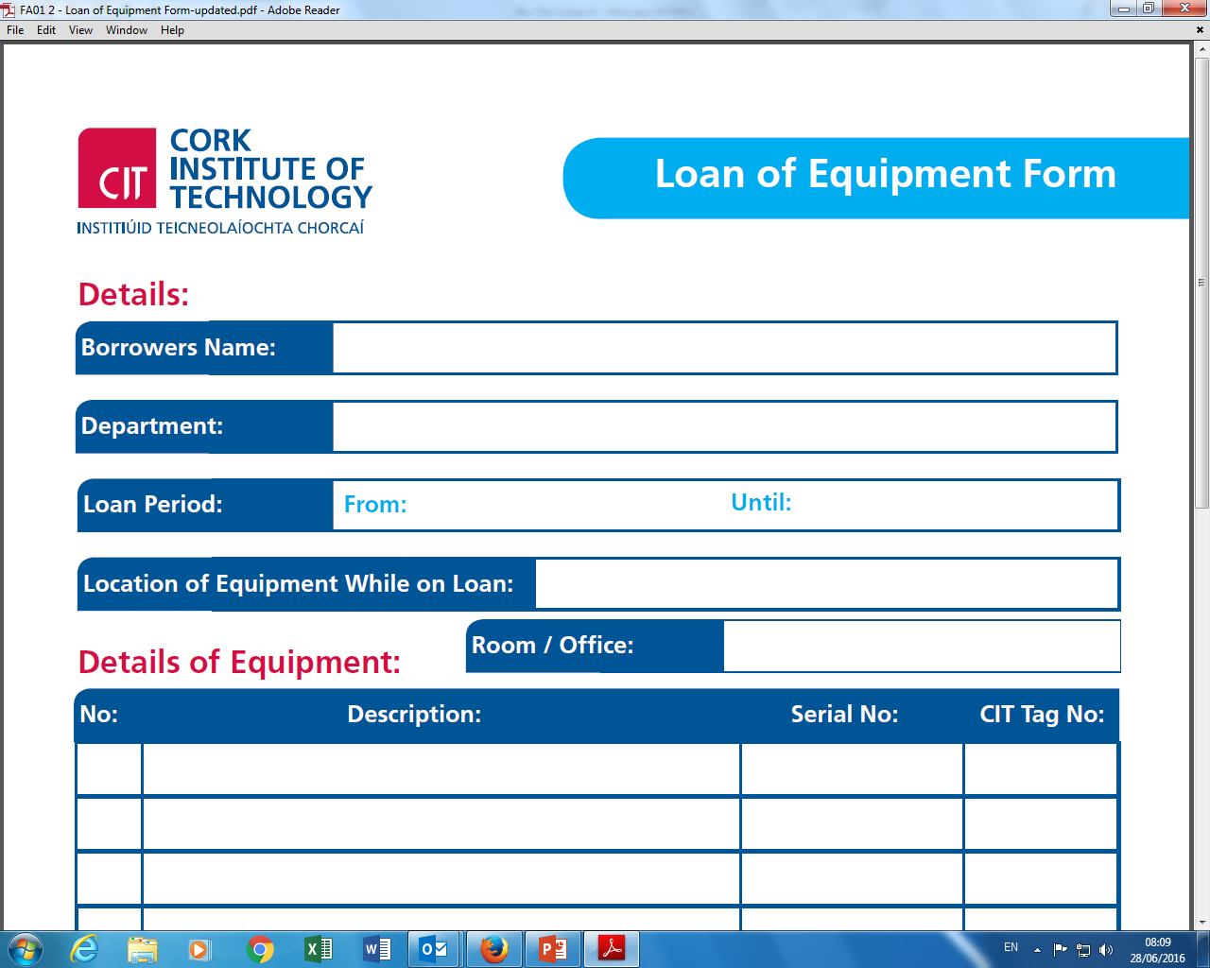

Slide 7
Locations
The checking & updating Locations on Agresso

Slide 8
Fixed Asset Office Update
Disposal Process
Fixed Asset Policy to receive disposal form before asset is disposed of or transferred.
Disposal form available on Finance website
Physical disposals of assets in August 2016 & January 2017

Slide 9
Physical Disposal Summer 2016
Wednesday 27th July – Friday 5th August
B149
Avail of a time slot
Equipment on the register only accepted with authorised Disposal form.
Notes:
Important to make the most of this facility and dispose of all assets which are faculty and not being used, might be in cupboards etc…
Extremely important all asset with a barcode are accompanied by an authorised disposal form – I will be updating as I receive equipment on the day.

Slide 10
Proposed Daft Schedule of Internal Rolling Audit 2016-2017
CIT Fixed Asset Internal Audit for the period July 2016- July 2017
NMCI & Cork School of Music
Faculty Of Engineering and Science Report
 |  |  | 2016 |  |  |  |  |  | 2017
 |  |  | July | August | September | October | November | December | January | February | March | April | May | June | July | Subtotal
Department |  |  | D700 | D600 |  | D500
 |  |  | D410 | D411 | D400 | D201 | D450 | D250 | D202 | D205 | D204 | D403 | D405 | D460 | D402
Numberrs for Audit
To be audited
%

Slide 11
Q & A

